Slide 1
Meso level analysis from the perspective of Heterodox Economics
Svetlana Kirdina-Chandler
Institute of Economics, Russian Academy of Sciences,
Moscow, Russia
Notes:
Thanks and my interest to meet with British Heterodox community here in the UK.

Slide 2

Motivation
Institutions, clusters, networks, associations and other structures require their own theoretical space - meso (Chen, 2008, p. 121)
But the meso level is not regarded as necessary within the micro-macro dichotomy, especially by mainstream economists. These include Thomas Shelling – the Nobel Prize Winer and specialist in game-theory analysis, Robert J. Barro – the founder of New Classical Macroeconomics, Jochen Runde – from the University of Cambridge, UK and similar.
Why heterodox economists strongly support the idea of meso level analysis and what it is useful for?
Notes:
My interest in meso level analysis began with institutional theory in economics and sociology, and my understanding that institutions are not only the particular focus of analysis but also the locus of analysis. So they form their own space, as Ping Chen wrote in 2008. … Mainstream economists dispute the need for a meso level theory of economics. Indeed, meso level research IS MORE AND MORE POPULAR ESPECIALLY WITH HETERODOX ECONOMISTS.

Slide 3
Outline
The growth of attention to meso level analysis in the 21st century - why?
Ontological factors of dissatisfaction with the traditional micro-macro dichotomy.
Epistemological factors and new research paradigms.
Meso level analysis in neoclassical economics.
The essence of the heterodox approach to meso level analysis.
Methodological institutionalism as the new premise to obtain new results in meso economics.
Notes:
It motivated me to prepare the paper with the following structure:

Slide 4

Logarithmic graph of the growth rate of publications from the requests of "microeconomics", "macroeconomics" and "mesoeconomics", based on Google Scholar, 1981-2017
https://forum.volnistye.ru/viewtopic.php?t=9693
Notes:
The starting point for this Graph is 1981 because only since 1980 have papers about the meso level started to be published on a regular basis. Before that time one can only find rare single publications. We can see that the share of meso level papers in comparison with publications on the macro and micro levels is very small. But over the last 35 years the number of meso level publications, compared with other levels of economic analysis, is growing ten times faster.
We considered economic papers where Meso was a part of the title, or was presented in key words or was in the text of abstracts. You can see in the graph that meso level research is beginning to develop into maturity like a small bird.

Slide 5
Papers on the meso level in the heterodox Journal of Institutional Economics (which was founded in 2005)
Notes:
In heterodox journals this trend is much more visible. Here you can see the growth of meso level publications in the Journal of Institutional Economics which was founded in 2005 by the European Association for Evolutionary Political Economy. What are the reasons why economists are paying more attention to meso level analysis?

Slide 6
dissatisfaction with the traditional micro-macro dichotomy
Ontological factors:

Slide 7
Neither complexity nor cyclicity is explained
The micro-macro dichotomy in economics does not take into account the growing complexity of the economy.
Also mainstream economics cannot predict and explain the causes of recurrent and increasing global crises.
Notes:
As Baumol wrote, macroeconomic models, in his opinion, are outside real history and "do not contain anything that would distinguish market economies from the economies of the Soviet type or from the economies of Ancient Rome and medieval China“.
We know the story when Queen Elisabeth 2nd asked academics why no one had foreseen the “awful” financial crisis of 2008. They acknowledged the limitations of economic theory in this sense.

Slide 8

Crises and structuring of Economics
Microeconomics: 1870-1920s (before the Great Depression)
Microeconomics+ Macroeconomics: 1930-1980s (before the energy crises of the 1970-80s)
Microeconomics+ Macroeconomics+ Mesoeconomics 1990 onwards (after the dot-com bubble and especially after the 2008 crisis)
https://www.google.ru/search?q=%D1%81%D0%BB%D0%BE%D0%B6%D0%BD%D0%BE%D1%81%D1%82%D1%8C&newwindow=1&source=lnms&tbm=isch&sa=X&ved=0ahUKEwit8PzyuN_YAhXKMywKHRKICVkQ_AUICigB&biw=1270&bih=564#imgrc=A8qFNHepA2DzNM
Notes:
We can see how crises stimulated new developments in economic theory.

Slide 9
new research paradigms
Epistemological factors:

Slide 10
Reflections on the economy are also becoming more complicated: a new "episteme epoch” (M. Foucault)
A synergetic paradigm has come from chemistry and physics. It takes into account the complexity, non-equilibrium, hierarchy and nonlinearity of the processes occurring.
Development is understood as an irreversible process of evolution with successive changes in the hierarchy of structures and mechanisms of increasing complexity (“the Other Canon”).
Such evolving structures and mechanisms form the meso level of the economy.

Slide 11

New view of the economic world
The increasing complexity of economic reality and dissemination of new theoretical concepts have, together, contributed to the development of mesoeconomics, in addition to macro- and microeconomics.
Notes:
The world has become more complex and “multiplex’

Slide 12
Understanding the meso level
Conventional approach:
Micro level - individual actors and their behavior;
Macro level - an aggregate at the level of national or global economies;
Meso level - an intermediate level: large corporations, industries or regional economic complexes.
Institutional approach:
"Meso" analysis is aimed at studying the mechanisms of the influence of macroeconomic decisions on micro-level agents (Stewart, 1992; Rodgers and Cooley, 1999);
“The economic system is a rule-system contained in what we call the meso” (Dopfer, Foster, Potts, 2004);
At the meso level the evolution of institutions ensures the cooperation of individual and group activities which take place (Elsner, 2007, 2010).

Slide 13
The meso level as a subject for investigation
Neoclassical approach:
The study of the meso level of the economy is based on micro-foundations (the same as for the macro level). Among them are the prerequisites of the rationality of economic agents, the profit maximization and equilibrium principle.
Heterodox approach:
The meso level includes structures and mechanisms that determine the patterns and rules of interaction, as well as the proportions of economic reproduction, which ensure the development of the economy as a whole. They depend on history, culture, geography and similar aspects.

Slide 14
A new premise to investigate the meso level in economics
Methodological institutionalism:

Slide 15
Methodological individualism as a core principle of mainstream economics
Methodological individualism "assumes an explanation of the social and economic phenomena in terms of individual behavior" (Lukes, 1973: Hodgson, 2003, 2007).
Methodological individualism has led to "neoclassical synthesis“ (Samuelson, 1967) and "new neoclassical synthesis“ (Woodford, 2009).

Slide 16
Methodological individualism and methodological holism
Methodological holism (Gruchy, 1947 ; Rutherford, 1989) is usually considered as an alternative to methodological individualism. Is this really true?
The principle of methodological holism is the epistemological philosophical premise which has been investigated since Aristotle (the IV century BC) and reflects an idea that "the whole is more than sum of its parts".
Its epistemological alternative is a reductionism (“the whole is understood as a set of primary elements forming it”)
A reductionism is expressed in economics as methodological individualism.
As for methodological holism, in economics it is still used “directly", without specification.

Slide 17
Institutional individualism as a middle way?
Institutional individualism (Agassi, 1960, 1975; Jarvie, 1972; Toboso, 1995, 2001, 2008).
If we summarize the views of institutional individualism supporters, we see that they are still focused on the analysis of human interactions in the institutional environment where "macroeconomic effects have to be presented as a result of interaction of certain actors within existing institutions" (Polterovich, 2011).
I agree with Jarvie (1972) that institutional individualism is a wider version of methodological individualism and it still contains "an explanation of the social and economic phenomena in terms of individual behavior".

Slide 18
Methodological institutionalism
The integrity of economic systems is provided with structures of institutions. Therefore identification of holistic and systemic principles in economics can be presented by methodological institutionalism.
Methodological institutionalism means an explanation of the social and economic phenomena in terms of the functioning and changes of institutional structures. Factors of institutional change are also explained.

Slide 19
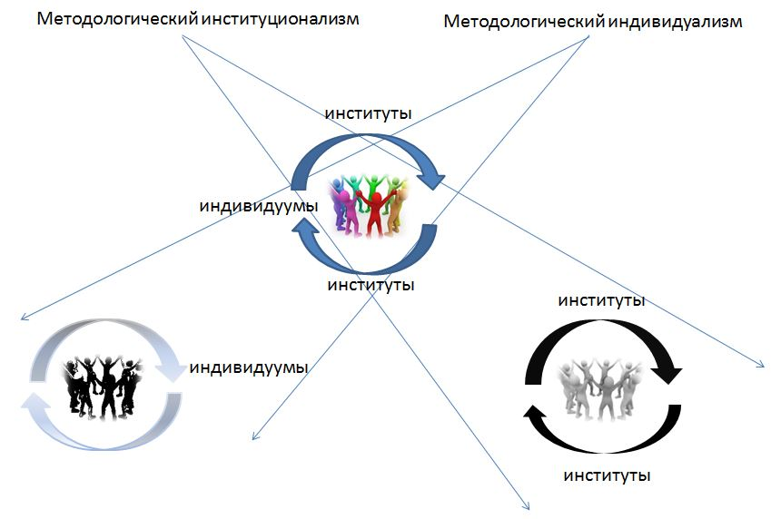

Slide 20
Examples of the application of methodological institutionalism
Eucken W. (1939). Die Grundlagen der Nationalökonomie. Jena: Gustav Fischer.
Eucken W. (1965). Grundsätze der Wirtschaftspolitik. Rowohlt: Reinbek.
Polanyi K. (1957). The Economy as Instituted Process. / The Sociology of Economic Life. Mark Granovetter and Richard Swedberg (eds.). Boulder, CO: Westview Press.
Kirdina S. (2013). New systemic institutional approach for comparative political and economic analysis. // Review of Radical Political Economy. September. Vol. 45. Number 3.

Slide 21
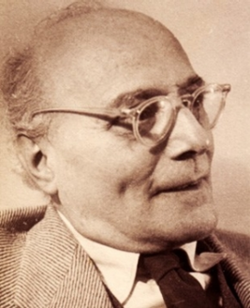
Karl Polanyi as one of the first researchers of the meso level on the basis of the methodological institutionalism principle
He showed that, from the same properties of economic agents attributed to them in the neoclassical micro level economics, different types of institutions are being created in the economy at the meso level to coordinate economic performance. Among them exchange (market), redistribution and reciprocity (Polanyi, 1977).
1886-1964

Slide 22
Meso level research for economic policy
Meso level research can be used to understand the balance between market and redistributive mechanisms; the depth of privatisation, nationalisation or publicisation (Andrew Purves); competition or cooperation (the creation of alliances); regulated prices or free pricing, etc, for the effective development of entire economic systems.

Slide 23
Question:
Could methodological institutionalism (Keizer, 2007; Kirdina, 2013) possibly be one of the core methodological principles for Heterodox Economics?

Slide 24

Discussion
Institutions are constantly evolving. However, in a manner similar to how new branches contribute toward the continuing growth of a tree, new institutions inherit existing characteristics and move forward, evolving from foundational institutional structures. Methodological Institutionalism gives us the lens to investigate this process.

Slide 25
Conclusion
For HE the meso level is clearly of primary interest, although there is not yet a consensus about the definition of the meso level.
Nevertheless, despite the differences in its interpretation attention is focused on that part of the economic system where the mechanisms of economic development arise and where they are identified during the interaction of economic agents (subjects, subsystems).
The meso level is associated with the realisation that it is here (rather than at micro or macro levels) that new economic and technological solutions are increasingly being constituted.
It is here that the endogenous mechanisms of economic growth are formed as well as the main obstacles to its achievement. Accordingly, the meso level becomes a subject of study in its own right in order to manage it, and to use the results obtained in the interests of the whole society.

Slide 26
JOINT
Association for Evolutionary Economics / European Association for Evolutionary Political Economy
SESSION
“Complexity Economics and Mesoeconomics:
Addressing the Exigencies and Contradictions of Today's Complex World”
AT THE 30TH ANNUAL EUROPEAN ASSOCIATION FOR EVOLUTIONARY POLITICAL ECONOMY CONFERENCE
NICE, FRANCE, 06-08 SEPTEMBER 2018

Slide 27
Thank you for your attention!
Спасибо за внимание!
kirdina777@gmail.com

